Slide 1
Superstores Sales Data Analysis Report Akbar Nawas Khan U 21-04-2025 DADS – MARCH 25

Slide 2
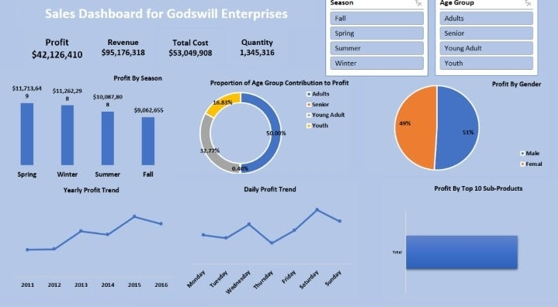
Project Objective
To analyze sales data to uncover trends, track performance, and provide insights to support data-driven decisions.
Key Goals:
Identify sales trends over time.
Find top-performing products and channels.
Measure the impact of discounts.
Create a dashboard to visualize key metrics.

Slide 3
Data Description and Preparation
Data Cleaning process:
Removed duplicates to avoid repeated records.
Filled missing values using appropriate methods (e.g., average, most common value).
Formatted dates and numbers to ensure consistency.
Fixed text issues like typos and inconsistent labels.
Filtered out irrelevant or incomplete entries.
Dataset Overview:
This report analyzes 9994 sales transactions, highlighting key metrics: average sales of $229.86 with a wide range, average quantity of 3.79 items, and average profit of $28.66. The dataset includes diverse shipping modes, customer segments, and product categories, with significant variability in discounts and profitability.

Slide 4
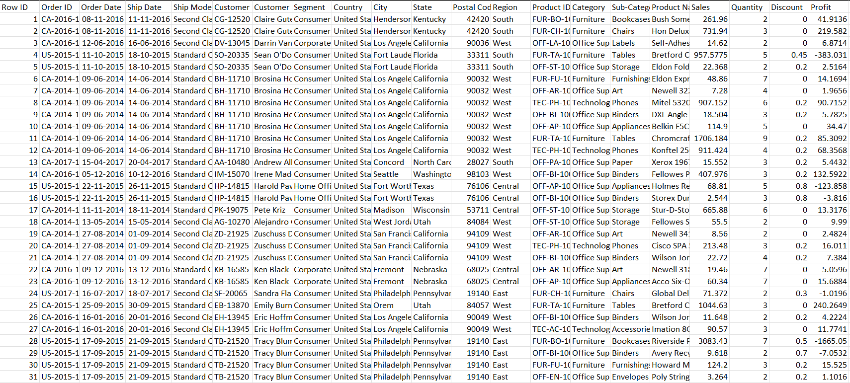
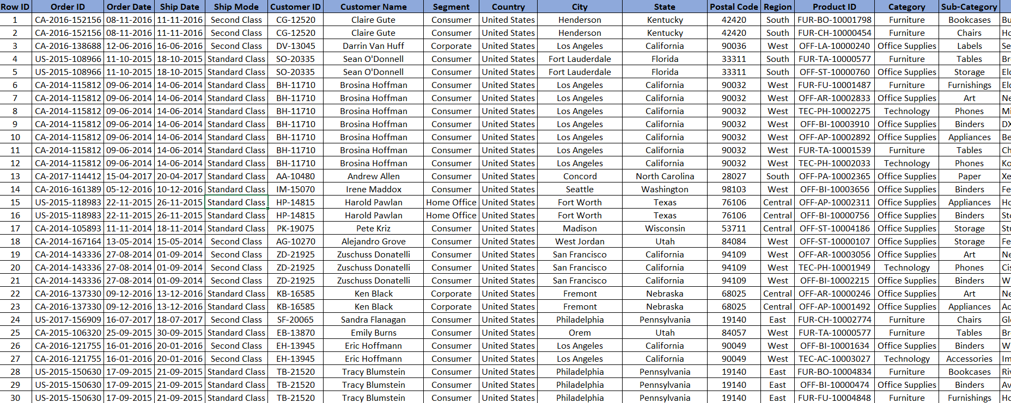
Visuals:
Before cleaning
After cleaning

Slide 5
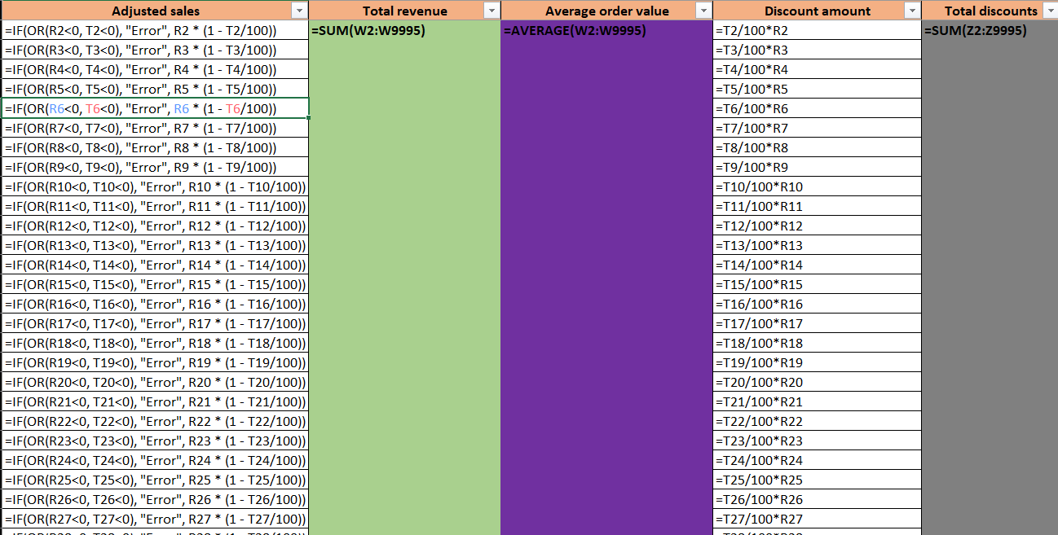
Key Metrics Calculation and Data Analysis
Total Sales:
Gross Sales = Quantity × Unit Price
Adjusted Sales = Net Sales – Discounts
Average Sales per Order:
Total Net Sales ÷ Number of Orders
Discount Rate:
Total Discounts ÷ Gross Sales
Sales by Channel/Product Type:
Used Pivot Tables and SUMIFS to break down sales by channel, region, and product category.

Slide 6
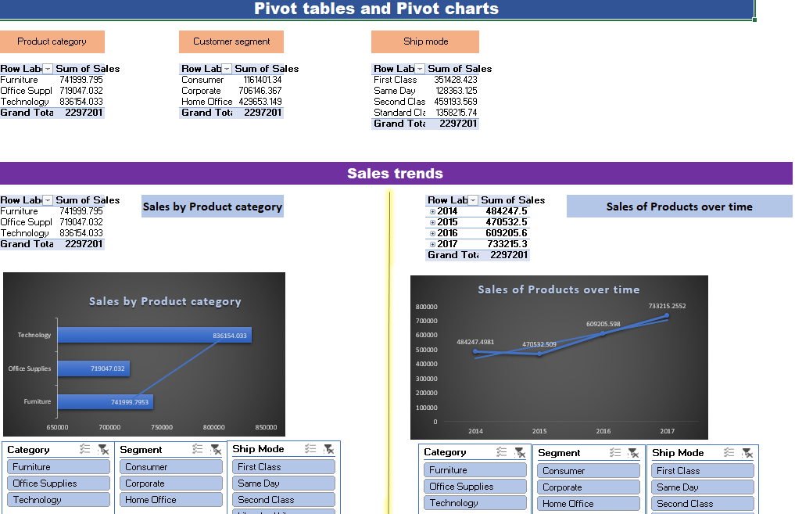
Pivot Table Summary PivotTables were used to quickly summarize and analyze sales data by different categories.
How They Were Used: Sales Channel: Showed total sales and order counts for each channel. Product Type: Compared sales by product category to find top sellers. Date: Grouped sales by month and year to spot trends over time. Other Filters: Used filters and slicers to view data by region, discount, or returns.

Slide 7
Pivot Chart Visualizations Pivot Charts were used to turn summarized data into easy-to-read visuals, helping to highlight key patterns and trends.

Slide 8
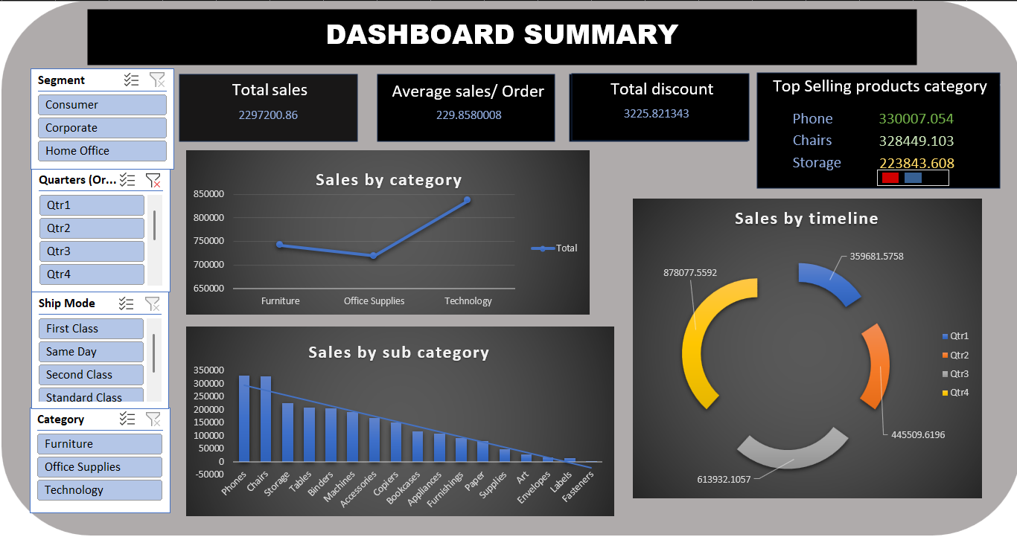
Dashboard Overview
Dashboard Design:
The dashboard was designed to make the sales data more interactive and easier to explore. It includes key performance indicators (KPIs), charts, and slicers to help users filter and analyze the data quickly.
Key Components:
KPIs:
Total Sales
Average Order Value
Total discount
Top selling product category
Charts:
Line chart for sales by category
Bar chart for top products or categories
Pie chart for sales by timeline
Slicers:
Interactive filters for date, product type, region, and channel

Slide 9
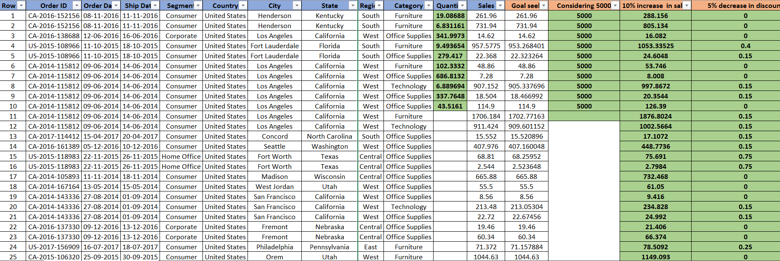
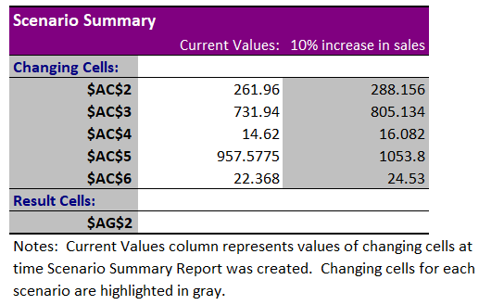
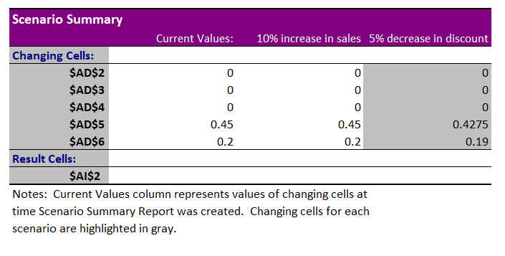
What-if Analysis & Goal seek
What-If Analysis:
What-If scenarios in Excel to see how changes in sales and discounts would affect total revenue.
For example:
Increased sales by 10%
Decreased discount by 5%
Goal Seek:
Used Excel’s Goal Seek to figure out how many units we need to sell to hit a revenue target.
Goal: 5000 in revenue
Inputs: cell with revenue was selected and changes in unit where seen.
Result:
This helped set realistic sales targets based on actual conditions.

Slide 10
Macros and Automation
Macro Recording:
Formatting raw data (e.g., adjusting column widths, setting headers, applying filters)
Running calculations (e.g., summing totals, applying formulas)
Generating weekly reports from updated datasets
By recording these actions once, I could repeat them with one click, saving a lot of manual effort.
Automation Benefits:
Using macros improved efficiency by:
Reducing task time from several minutes to seconds
Ensuring consistency in formatting and calculations
Minimizing errors from manual processing
Overall, macros helped speed up the analysis process and made report generation much smoother.

Slide 11
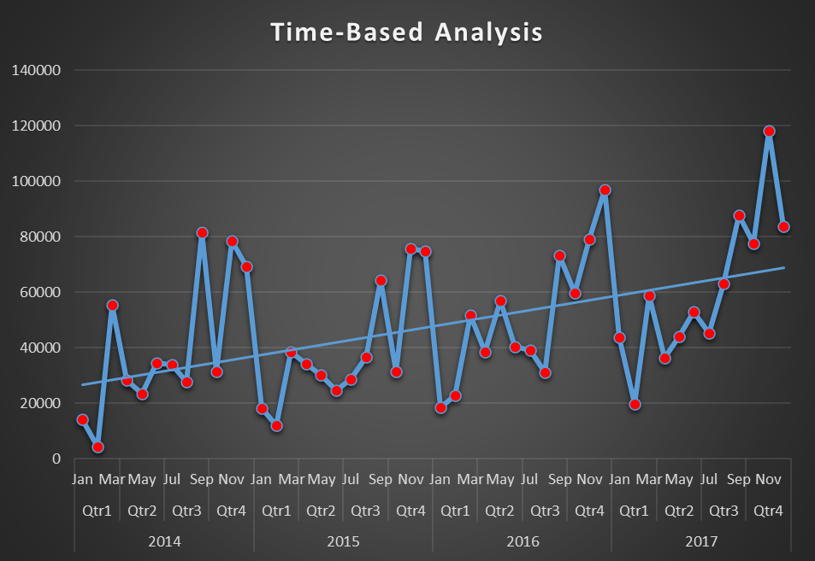
Insights and recommendations Key insights - Monthly Sales Trend and Growth
Monthly Sales and YoY Growth: Analysis from 2014 to 2017 shows significant fluctuations in sales, with peaks and troughs indicating seasonality.
Visualized Trend: Line chart with blue for total sales and yellow for YoY growth.
YoY Growth Insights: Highest growth in 2017-11 at nearly 2.0, lowest in 2015-05 at approximately -0.5.

Slide 12
Order-Ship Time Distribution Analysis
Shipping time varies significantly by ship mode: 'Same Day' is the fastest at 0.04 days, while 'Standard Class' is the slowest at 5.01 days.
Visualization: A bar chart highlights these differences, emphasizing the impact of ship mode choice on delivery time.
Visualize U.S. state sales distribution
Total Sales Calculation: Data grouped by 'State' and summed to create `state_sales_data` with 'Total Sales'.
Data Summary: 49 states analyzed; average sales $46,881.65, standard deviation $80,776.29. California highest at $457,687.63, North Dakota lowest at $919.91.
Conclusion and Insights: Significant sales variation; California and New York lead, while North Dakota and others lag, suggesting targeted strategies. Visualize with a choropleth map.

Slide 13
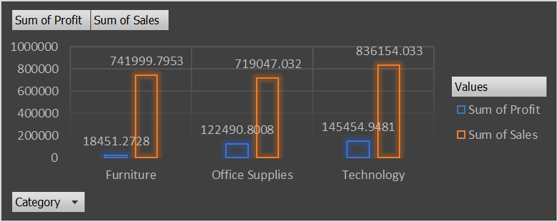
Product Sales and Profit Analysis
Technology Category Dominance: Leads in both total sales ($836,154.03) and total profit ($145,454.95), with the highest profit margin (17.4%).
Furniture Category Performance: Lowest total profit ($18,451.27) and profit margin.
Office Supplies Profitability: Lower sales than furniture, but higher total profit ($122,490.80) and profit margin.

Slide 14
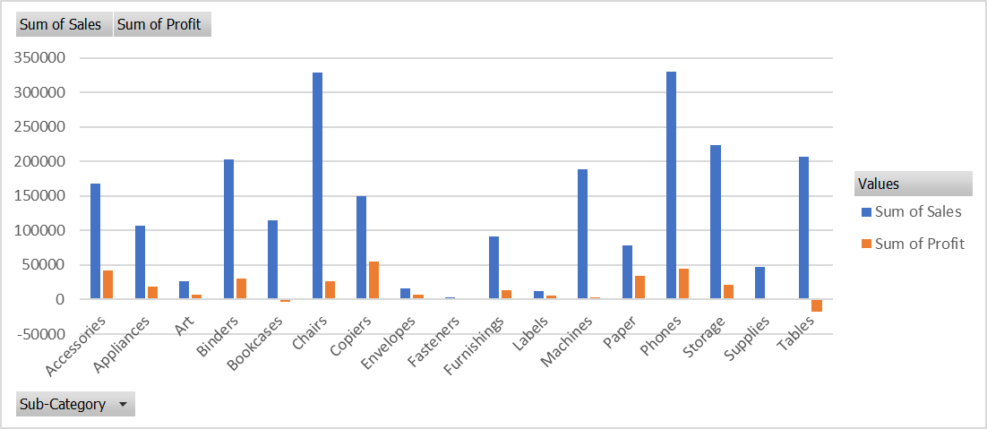
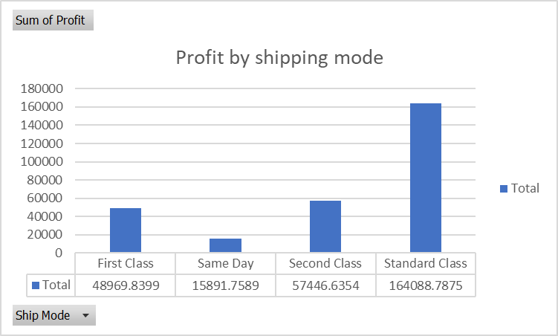
Sub-category sales and profit analysis
Labels have the highest profit margin at 44.42%.
Tables show a negative profit, indicating losses.
Copiers generated the highest profit of 55617.82.
Phones achieved the highest sales of 330007.05.
Most Profitable Ship Mode
Standard Class leads in both sales (1,358,215.74) and profit (164,088.79), making it the most profitable ship mode.
Same Day shipping records the lowest sales (128,363.12) and profit (15,891.76) among the modes.
Visual data highlights Standard Class as the top performer in sales and profit.

Slide 15
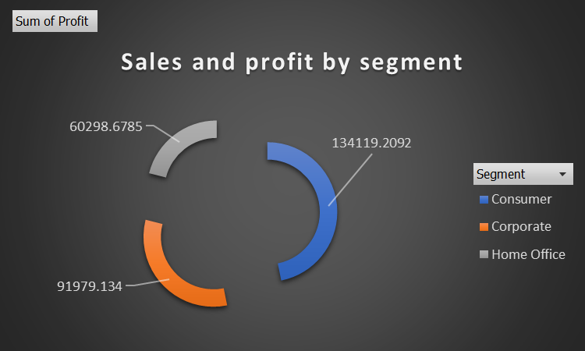
Sales and profit by segment
Consumer Segment Dominance: The Consumer segment leads with total sales of $1,161,401.35 and profit of $134,119.21.
Segment Performance Ranking: Profitability ranks as Consumer > Corporate > Home Office.
Strategic Focus: Prioritizing the Consumer segment could maximize returns; further analysis is advised.

Slide 16


Slide 17

Appreciate your support and co-operation

